Slide 1
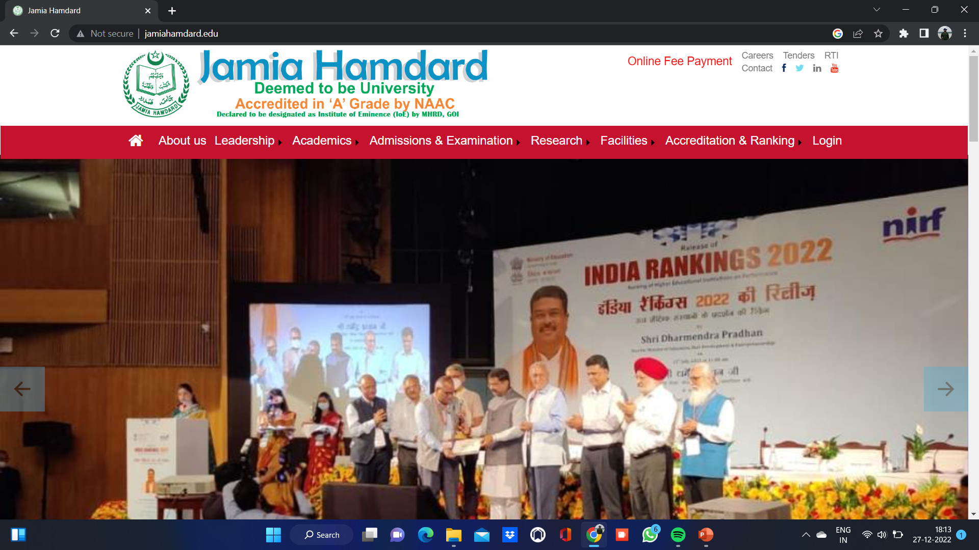
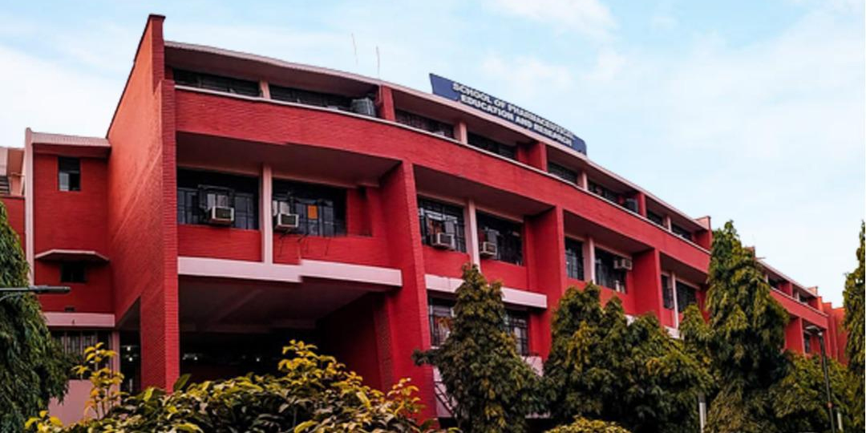
Session: 2022-2023
BENZIMIDAZOLE-FURANONES HYDBRID COMPOUNDS: SYNTHESIS AND ANTICANCER ACTIVITY
Presented by :
MD SANA ULLAH
(Enrolment No.: 2021-518-005)
Under the supervision of:
PROF. (DR.) ASIF HUSAIN (Supervisor)
DR. MD RAFI HAIDER (Co-Supervisor)
DEPT. OF PHARMACEUTICAL CHEMISTRY, SCHOOL OF PHARMACEUTICAL EDUCATION AND RESEARCH
JAMIA HAMDARD (DEEMED TO BE UNIVERSITY)
HAMDARD NAGAR, NEW DELHI-110062

Slide 2

TOPIC | SLIDE No.
CANCER | 3-4
HYBRID COMPOUNDS | 5
WHO REPORT ON CANCER,2022-23 | 6
CLASSIFICATION (ANTICANCER DRUGS) | 7
MECHANISM OF ACTION | 8-13
LITERATURE REVIEW: BENZIMIDAZOLE…………………………….. FURANONE…………………………………....... PYRROLONE……………………………………… | 14-34 17-23 24-30 31-34
AIM & OBJECTIVE | 35
EXPERIMENTAL WORK | 36-40
IN SILICO STUDY | 41-43
RESULTS & DISCUSSION | 44-52
REFERENCES | 53
CONCLUSION | 54

Slide 3
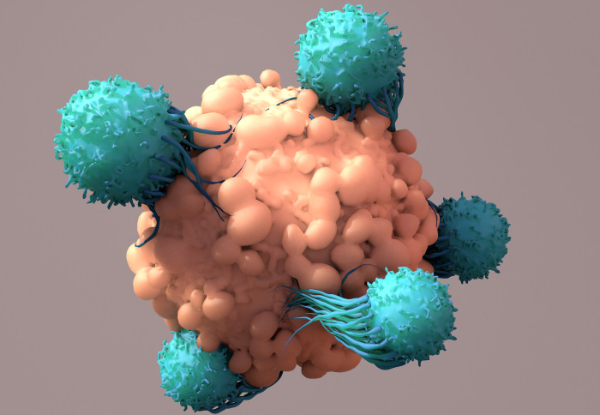
01
Cancer is termed as a group of diseases featuring abnormal cell growth by disregarding normal rules of cell division.
02
Normal cells are constantly subjected to signals that dictate whether the cell should divide, differentiate or die.
03
Cancer cells develop a degree of autonomy from these signals, resulting in uncontrolled growth and proliferation.

Slide 4
04
Many existing anti-cancer drugs is limited by their toxicity to normal growing cells in the intestinal and bone marrow areas
05
The non specificity of current marketed drugs in turn leads to the common side effects like hair loss, anaemia, nausea, vomiting, dizziness, etc.
06
Attempts are made to synthesize some novel heterocyclic and hybrid heterocyclic compound with more potency and less side effect.

Slide 5
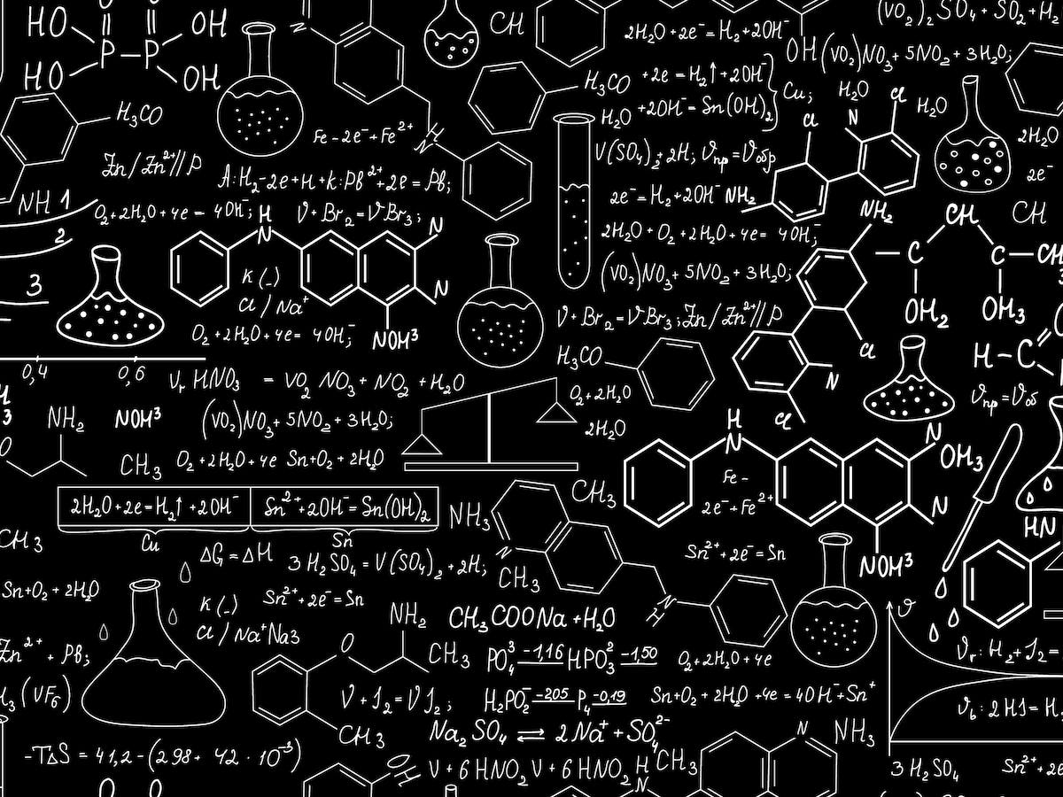
WHY?
01
Anticancer chemotherapy is hindered due to the multidrug resistance phenomenon. Recent new strategy involves the synthesis of the hybrid compounds as multitargeted anticancer agents.
In hybrid compounds two or more bioactive moieties are conjugated to a single unit. These compounds having more than a single target are considered more efficient and potent anticancer agents.
ADVANTAGE
Benzimidazole-Furanone Hybrid compound consists of two pharmacophore- Benzimidazole and Furanone can exhibits anticancer effect individually.
Hybrid compounds can also overcome many disadvantages of single cancer drugs such as low solubility, adverse effects and multidrug resistance.
ADVANTAGE
These pharmacophores are joined together in a compound, that can inhibit the growth of cancer cells more efficiently.

Slide 6



WHO Report on cancer, 2022
Cancer mortality is the number of deaths due to cancer occurring in a specified population over a given period of time (typically 1 year).
It can be expressed as an absolute number of deaths within the entire population per year or as a rate per 100 000 persons per year.

Slide 7

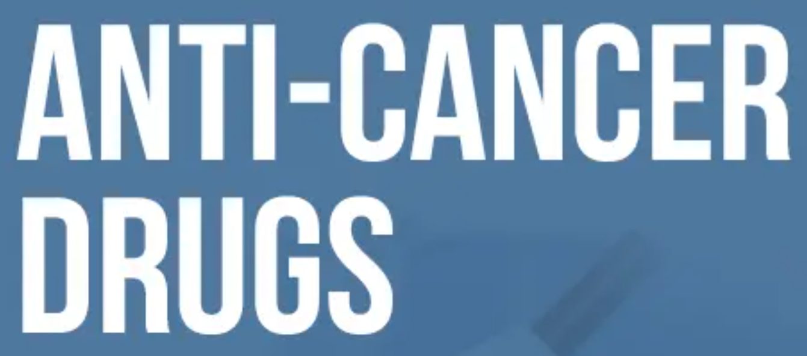
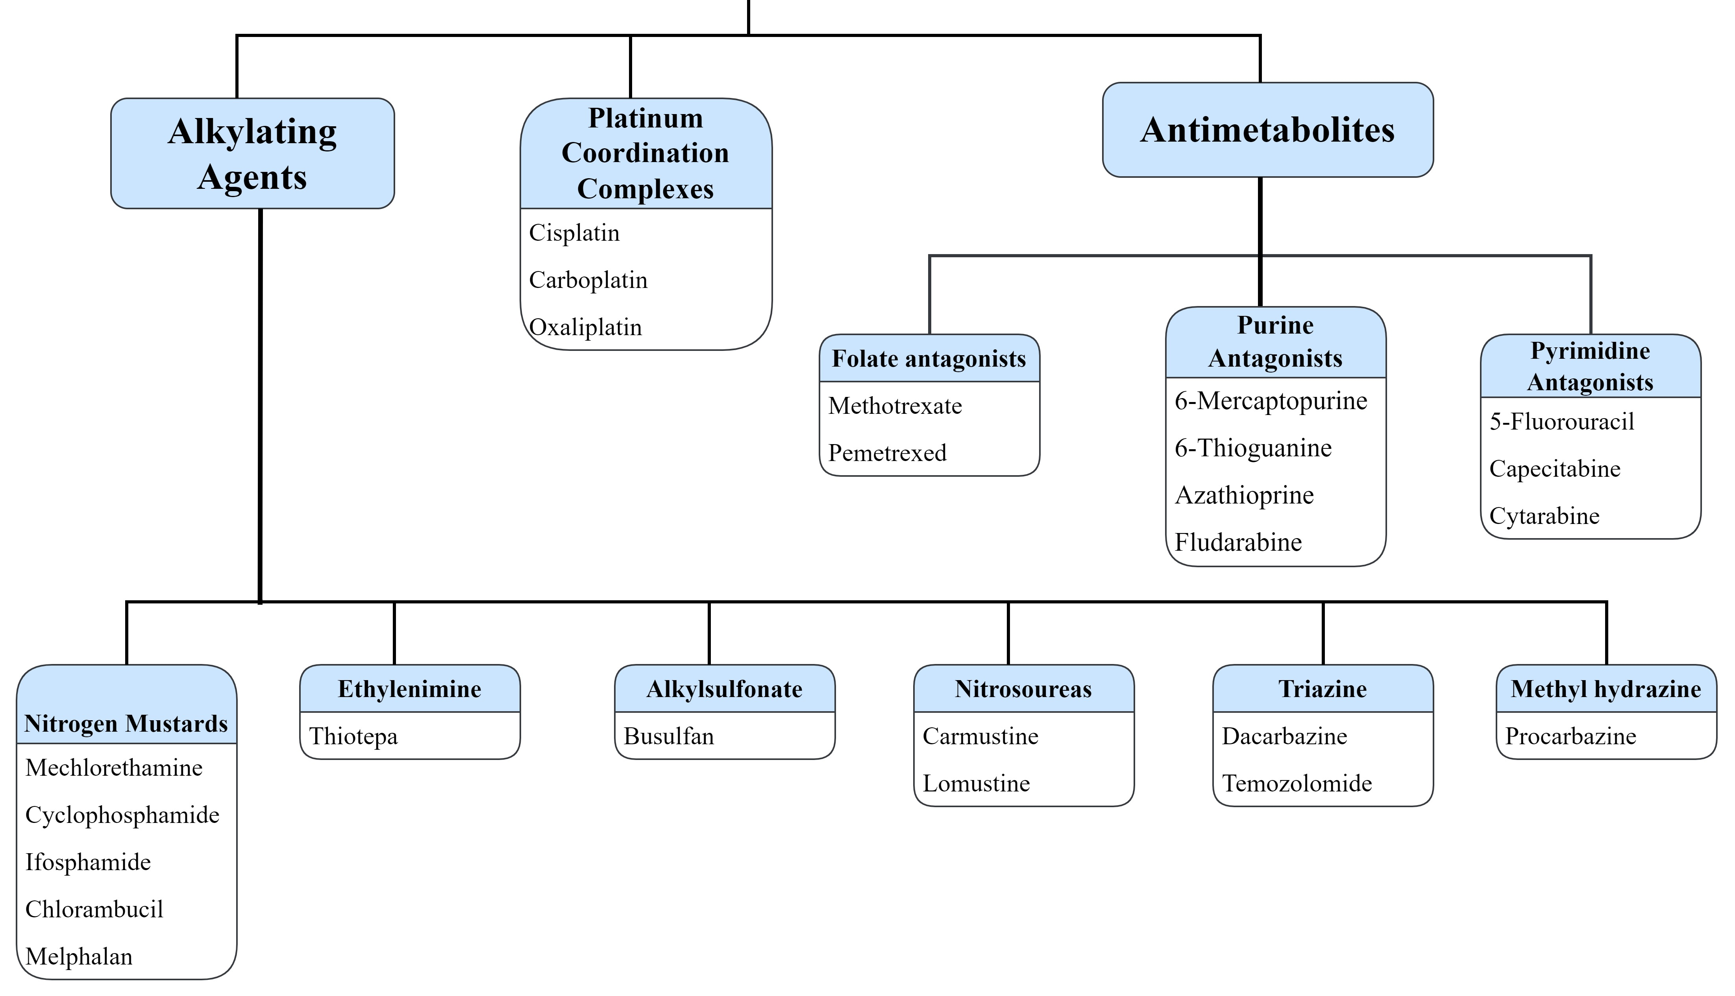
Cancer cells generally disturb the cell signalling pathways and tissue morphogenesis for the neoplastic propagation of tumors.
Targeting these cell pathways by cytotoxic agents have been proven therapeutic approaches to subside tumor growth and disease progression.

Slide 8
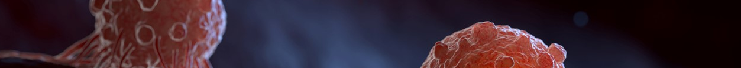
01
02
03
Interfere with DNA structure and function:
1. Blocking the synthesis of DNA (e.g., 6-mercaptopurine).
2. Incorporated into DNA and then interfere with its function (e.g., 6-thio-guanine).
Interact directly with DNA:
1. Intra-strand (e.g., cisplatin) or Inter-strand (e.g., nitrogen mustards) cross-linking
2. Intercalation between base pairs (e.g., mitoxantrone)
3. Alkylation in the minor groove (e.g., trabectedin), & methylation in the major groove (e.g., temozolomide)
Involve in strand scission (i.e., cleavage) at the binding site (e.g., bleomycin)
Interfere with the structural proteins important for the processing of DNA (/histone deacetylase inhibitors e.g., vorinostat).

Slide 9
01
02
03
Interfere with DNA structure and function:
1. Blocking the synthesis of DNA (e.g., 6-mercaptopurine).
2. Incorporated into DNA and then interfere with its function (e.g., 6-thio-guanine).
Interact directly with DNA:
1. Intra-strand (e.g., cisplatin) or Inter-strand (e.g., nitrogen mustards) cross-linking
2. Intercalation between base pairs (e.g., mitoxantrone)
3. Alkylation in the minor groove (e.g., trabectedin), & methylation in the major groove (e.g., temozolomide)
Involve in strand scission (i.e., cleavage) at the binding site (e.g., bleomycin)
Interfere with the structural proteins important for the processing of DNA (/histone deacetylase inhibitors e.g., vorinostat).

Slide 10
01
02
03
Interfere with DNA structure and function:
1. Blocking the synthesis of DNA (e.g., 6-mercaptopurine).
2. Incorporated into DNA and then interfere with its function (e.g., 6-thio-guanine).
Interact directly with DNA:
1. Intra-strand (e.g., cisplatin) or Inter-strand (e.g., nitrogen mustards) cross-linking
2. Intercalation between base pairs (e.g., mitoxantrone)
3. Alkylation in the minor groove (e.g., trabectedin), & methylation in the major groove (e.g., temozolomide)
Involve in strand scission (i.e., cleavage) at the binding site (e.g., bleomycin)
Interfere with the structural proteins important for the processing of DNA (/histone deacetylase inhibitors e.g., vorinostat).

Slide 11
04
05
06
Interfering biosynthetic pathways:
1. Antimetabolites (e.g., methotrexate)
2. Anti-tubulin agents (e.g., vinblastine and the taxanes) interfere with cell division.
3. Selectively blocking pathways involved in cell signaling (e.g., imatinib).
Endocrine (or hormonal) agents:
1.Blockade of the estrogen receptor (e.g., tamoxifen) or
2. Steroidal biosynthesis via aromatase inhibition (e.g., anastrozole).
Antibodies and antibody-drug conjugates (such as prodrugs)
RNA or protein-protein interactions (e.g., p53/HDM2)

Slide 12
04
05
06
Interfering biosynthetic pathways:
1. Antimetabolites (e.g., methotrexate)
2. Anti-tubulin agents (e.g., vinblastine and the taxanes) interfere with cell division.
3. Selectively blocking pathways involved in cell signaling (e.g., imatinib).
Endocrine (or hormonal) agents:
1.Blockade of the estrogen receptor (e.g., tamoxifen) or
2. Steroidal biosynthesis via aromatase inhibition (e.g., anastrozole).
Antibodies and antibody-drug conjugates (such as prodrugs)
RNA or protein-protein interactions (e.g., p53/HDM2)

Slide 13
04
05
06
Interfering biosynthetic pathways:
1. Antimetabolites (e.g., methotrexate)
2. Anti-tubulin agents (e.g., vinblastine and the taxanes) interfere with cell division.
3. Selectively blocking pathways involved in cell signaling (e.g., imatinib).
Endocrine (or hormonal) agents:
1.Blockade of the estrogen receptor (e.g., tamoxifen) or
2. Steroidal biosynthesis via aromatase inhibition (e.g., anastrozole).
Antibodies and antibody-drug conjugates (such as prodrugs)
RNA or protein-protein interactions (e.g., p53/HDM2)

Slide 14





HETEROCYCLIC COMPOUNDS
Cyclic compounds that contain at least one carbon atom and at least one other element, such as nitrogen (N), oxygen (O), or sulfur (S), within the ring.
The stability of these rings is influenced by two factors:
The presence of less distorted bond angles, resulting in reduced strain, and
The maximum number of conjugated double bonds.

Slide 15
HETEROCYCLIC COMPOUNDS
Heterocyclic compounds have wide-ranging applications in various fields, including pharmaceuticals, agrochemicals, and veterinary products.
Cyclic compounds that contain at least one carbon atom and at least one other element, such as nitrogen (N), oxygen (O), or sulfur (S), within the ring.
The stability of these rings is influenced by two factors:
The presence of less distorted bond angles, resulting in reduced strain, and
The maximum number of conjugated double bonds.

Slide 16
HETEROCYCLIC COMPOUNDS
Heterocyclic compounds have wide-ranging applications in various fields, including pharmaceuticals, agrochemicals, and veterinary products.
Cyclic compounds that contain at least one carbon atom and at least one other element, such as nitrogen (N), oxygen (O), or sulfur (S), within the ring.
These compounds display diverse physical, chemical, and biological properties, making them highly valuable in the medical field and pharmaceutical industry.
The stability of these rings is influenced by two factors:
The presence of less distorted bond angles, resulting in reduced strain, and
The maximum number of conjugated double bonds.

Slide 17
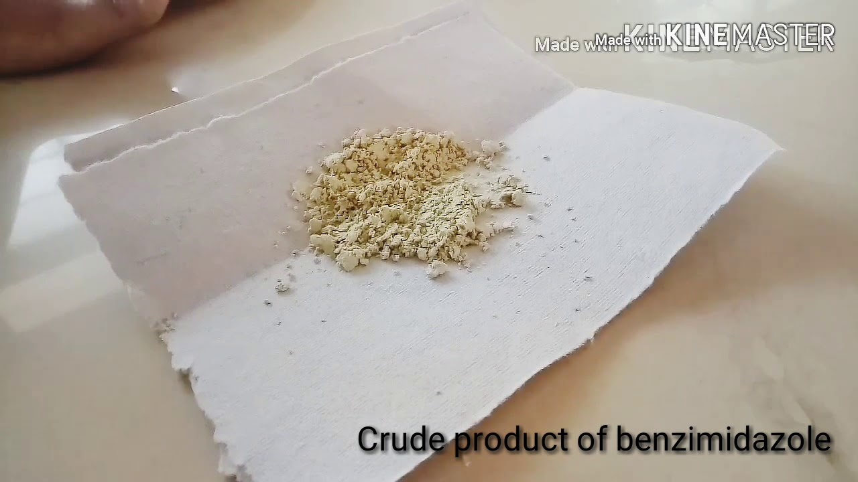
Benzimidazole, a derivative of imidazole with a benzene ring fused to a five-membered imidazole ring at the 4- and 5-positions, is a bicyclic aromatic organic compound.
It was initially synthesized by Hobrecker in 1872.
Essential pharmacophore in numerous biologically active heterocyclic compounds, exhibiting a diverse range of pharmacological activities.
Valued for their effectiveness in various bioactive compounds such as analgesics, antifungals, anti-inflammatory agents, antihypertensives, proton pump inhibitors, anti-HIV medications, antivirals, and anticancers.

Slide 18
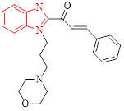
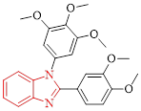
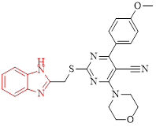
Author | Scheme | Findings | Structure
Cheng-Ying Hsieh et al (2019) | Synthesized new molecules comprising a benzimidazole ring, arene, and alkyl chain-bearing cyclic moieties. | The IC₅₀ values of compound for cancer cells were observed at 10.76 μM.
Ya-Liang Zhang et al (2020) | Synthesized 1,2-Diarylbenzimidazole derivatives (block tumor cells in G2/M phase, then affecting mitosis) | The microtubule inhibition value of compound was 8.47 μM.
Wang Haoran et al (2021) | Synthesized benzimidazole pendant cyanopyrimidine derivatives (compound had shown highest value of growth inhibition against HOP-92 and T-47D cancer cell lines) | Compound exhibited 88.84% and 84.19% growth inhibitory activity against HOP-92 and T-47D resepectively.

Slide 19
Author | Scheme | Findings | Structure
Cheng-Ying Hsieh et al (2019) | Synthesized new molecules comprising a benzimidazole ring, arene, and alkyl chain-bearing cyclic moieties. | The IC₅₀ values of compound for cancer cells were observed at 10.76 μM.
Ya-Liang Zhang et al (2020) | Synthesized 1,2-Diarylbenzimidazole derivatives (block tumor cells in G2/M phase, then affecting mitosis) | The microtubule inhibition value of compound was 8.47 μM.
Wang Haoran et al (2021) | Synthesized benzimidazole pendant cyanopyrimidine derivatives (compound had shown highest value of growth inhibition against HOP-92 and T-47D cancer cell lines) | Compound exhibited 88.84% and 84.19% growth inhibitory activity against HOP-92 and T-47D resepectively.

Slide 20
Author | Scheme | Findings | Structure
Cheng-Ying Hsieh et al (2019) | Synthesized new molecules comprising a benzimidazole ring, arene, and alkyl chain-bearing cyclic moieties. | The IC₅₀ values of compound for cancer cells were observed at 10.76 μM.
Ya-Liang Zhang et al (2020) | Synthesized 1,2-Diarylbenzimidazole derivatives (block tumor cells in G2/M phase, then affecting mitosis) | The microtubule inhibition value of compound was 8.47 μM.
Wang Haoran et al (2021) | Synthesized benzimidazole pendant cyanopyrimidine derivatives (compound had shown highest value of growth inhibition against HOP-92 and T-47D cancer cell lines) | Compound exhibited 88.84% and 84.19% growth inhibitory activity against HOP-92 and T-47D resepectively.

Slide 21
Author | Scheme | Findings | Structure
N. Perin et al (2020) | Synthesized, and evaluated the biological properties of new acrylonitrile derivatives substituted with 2-benzimidazolyl | Compound showed selective inhibitory activity (IC₅₀ 0.2 – 0.6 mM) against various cancer cell lines.
Vaishali S. Shinde et al (2021) | Synthesized benzimidazole nucleosides through Vorbrüggen glycosylation reaction using easily accessible D-glucose | Compound evaluated for anticancer activity using MDA-MB-231 cell line (IC₅₀ 0.79 ± 0.02 μM for 72 h)
Nishant K. Rasal et al (2021) | Synthesized derivatives bearing benzimidazole moiety through a molecular hybridization approach | Compound showed promising activity against MDA-MB-435 cell line of melanoma (Growth inhibition: 62.46%)

Slide 22
Author | Scheme | Findings | Structure
N. Perin et al (2020) | Synthesized, and evaluated the biological properties of new acrylonitrile derivatives substituted with 2-benzimidazolyl | Compound showed selective inhibitory activity (IC₅₀ 0.2 – 0.6 mM) against various cancer cell lines.
Vaishali S. Shinde et al (2021) | Synthesized benzimidazole nucleosides through Vorbrüggen glycosylation reaction using easily accessible D-glucose | Compound evaluated for anticancer activity using MDA-MB-231 cell line (IC₅₀ 0.79 ± 0.02 μM for 72 h)
Nishant K. Rasal et al (2021) | Synthesized derivatives bearing benzimidazole moiety through a molecular hybridization | Compound showed promising activity against MDA-MB-435 cell line of melanoma (Growth inhibition: 62.46%)

Slide 23
Author | Scheme | Findings | Structure
N. Perin et al (2020) | Synthesized, and evaluated the biological properties of new acrylonitrile derivatives substituted with 2-benzimidazolyl | Compound showed selective inhibitory activity (IC₅₀ 0.2 – 0.6 mM) against various cancer cell lines.
Vaishali S. Shinde et al (2021) | Synthesized benzimidazole nucleosides through Vorbrüggen glycosylation reaction using easily accessible D-glucose | Compound evaluated for anticancer activity using MDA-MB-231 cell line (IC₅₀ 0.79 ± 0.02 μM for 72 h)
Nishant K. Rasal et al (2021) | Synthesized derivatives bearing benzimidazole moiety through a molecular hybridization | Compound showed promising activity against MDA-MB-435 cell line of melanoma (Growth inhibition: 62.46%)

Slide 24

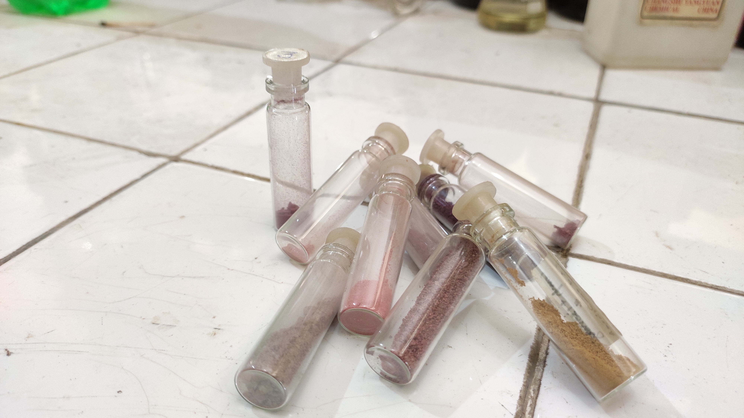
Furanone is a chemical compound that includes a furan ring, which is a five-membered aromatic ring containing four carbon atoms and one oxygen atom.
In the context of natural product synthesis, furanones are commonly referred to as "butenolides."
Wide range of therapeutic applications associated with furanone, many chemists have focused their attention on it as a novel synthetic target.
Furanone derivatives are synthesized worldwide as highly potent drugs exhibiting various pharmacological activities (anticancer, analgesic, anti-inflammatory, antibacterial, anticonvulsant, antifungal, antimalarial, etc.)

Slide 25
Author | Scheme | Findings | Structure
Anna Byczek-Wyrostek et al (2017) | Synthesized series of 5-alkoxy derivatives of 3,4-dichloro-5 hydroxyfuran-2-(5H)-one (mucochloric acid, MCA) | Investigation revealed compound led to G2 phase cell cycle arrest and induction of caspase-independent cell death.
Takayuki Irie et al (2018) | Designed, synthesized novel furanone derivatives through the HTS campaign in the presence of Cdc7 kinase inhibitors. | Compound was identified as a strong inhibitor of Cdc7 with an IC₅₀ value of 0.6nM.
Meng-Xue Wei et al (2017) | Synthesized a series of novel dithiocarbamates that incorporate a 2(5H)-furanone-piperazine group | Compound demonstrated the highest activity against HeLa cell lines, with an IC₅₀ value of 0.06 ± 0.01 mM

Slide 26
Author | Scheme | Findings | Structure
Anna Byczek-Wyrostek et al (2017) | Synthesized series of 5-alkoxy derivatives of 3,4-dichloro-5 hydroxyfuran-2-(5H)-one (mucochloric acid, MCA) | Investigation revealed compound led to G2 phase cell cycle arrest and induction of caspase-independent cell death.
Takayuki Irie et al (2018) | Designed, synthesized novel furanone derivatives through the HTS campaign in the presence of Cdc7 kinase inhibitors. | Compound was identified as a strong inhibitor of Cdc7 with an IC₅₀ value of 0.6nM.
Meng-Xue Wei et al (2017) | Synthesized a series of novel dithiocarbamates that incorporate a 2(5H)-furanone-piperazine group | Compound demonstrated the highest activity against HeLa cell lines, with an IC₅₀ value of 0.06 ± 0.01 mM

Slide 27
Author | Scheme | Findings | Structure
Anna Byczek-Wyrostek et al (2017) | Synthesized series of 5-alkoxy derivatives of 3,4-dichloro-5 hydroxyfuran-2-(5H)-one (mucochloric acid, MCA) | Investigation revealed compound led to G2 phase cell cycle arrest and induction of caspase-independent cell death.
Takayuki Irie et al (2018) | Designed, synthesized novel furanone derivatives through the HTS campaign in the presence of Cdc7 kinase inhibitors. | Compound was identified as a strong inhibitor of Cdc7 with an IC₅₀ value of 0.6nM.
Meng-Xue Wei et al (2017) | Synthesized a series of novel dithiocarbamates that incorporate a 2(5H)-furanone-piperazine group | Compound demonstrated the highest activity against HeLa cell lines, with an IC₅₀ value of 0.06 ± 0.01 mM

Slide 28
Author | Scheme | Findings | Structure
Yan-Cheng Wu et al (2018) | Designed and synthesized 4-biphenylamino-5-halo-2(5H)-furanones by incorporating the aminobiphenyl or benzidine structure. | 17.92% of the MCF-7 cells treated with 40 μM of compound were arrested in the G2/M phase. This proportion increased to 35.13% after 72 hours
Shi-He Luo et al (2021) | Synthesized series of amino acid derivatives via a metal-free C–N coupling reaction of 5-alkoxy-3,4-dihalo-2(5H)-furanones and amino acids | Compound have IC₅₀ value 40.22 ± 0.57 for Max concentration: 300 Μm.
Kai Yang et al (2021) | Designed and efficiently synthesized series of (E)-N-2(5H)-furanonyl sulfonyl hydrazone derivatives via one-pot reaction at room temperature | Compound exhibits high cytotoxic activity against MCF-7 human breast cancer cells with an IC₅₀ value of 14.35 μM.

Slide 29
Author | Scheme | Findings | Structure
Yan-Cheng Wu et al (2018) | Designed and synthesized 4-biphenylamino-5-halo-2(5H)-furanones by incorporating the aminobiphenyl or benzidine structure. | 17.92% of the MCF-7 cells treated with 40 μM of compound were arrested in the G2/M phase. This proportion increased to 35.13% after 72 hours
Shi-He Luo et al (2021) | Synthesized series of amino acid derivatives via a metal-free C–N coupling reaction of 5-alkoxy-3,4-dihalo-2(5H)-furanones and amino acids | Compound have IC₅₀ value 40.22 ± 0.57 for Max concentration: 300 Μm.
Kai Yang et al (2021) | Designed and efficiently synthesized series of (E)-N-2(5H)-furanonyl sulfonyl hydrazone derivatives via one-pot reaction at room temperature | Compound exhibits high cytotoxic activity against MCF-7 human breast cancer cells with an IC₅₀ value of 14.35 μM.

Slide 30
Author | Scheme | Findings | Structure
Yan-Cheng Wu et al (2018) | Designed and synthesized 4-biphenylamino-5-halo-2(5H)-furanones by incorporating the aminobiphenyl or benzidine structure. | 17.92% of the MCF-7 cells treated with 40 μM of compound were arrested in the G2/M phase. This proportion increased to 35.13% after 72 hours
Shi-He Luo et al (2021) | Synthesized series of amino acid derivatives via a metal-free C–N coupling reaction of 5-alkoxy-3,4-dihalo-2(5H)-furanones and amino acids | Compound have IC₅₀ value 40.22 ± 0.57 for Max concentration: 300 Μm.
Kai Yang et al (2021) | Designed and efficiently synthesized series of (E)-N-2(5H)-furanonyl sulfonyl hydrazone derivatives via one-pot reaction at room temperature | Compound exhibits high cytotoxic activity against MCF-7 human breast cancer cells with an IC₅₀ value of 14.35 μM.

Slide 31

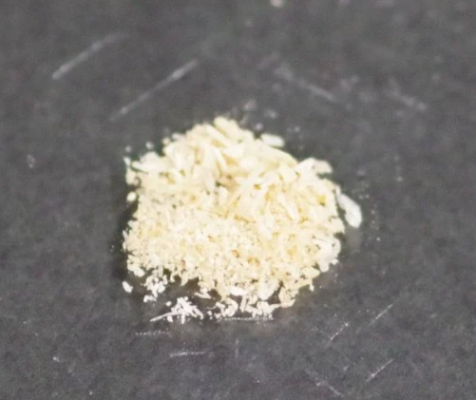
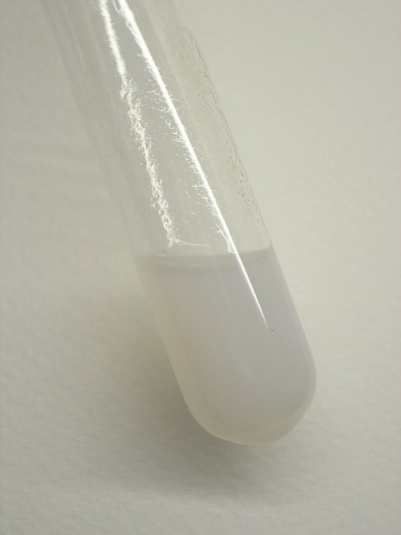
A group of five-membered heterocyclic lactams, which can exist as either Δ³ (I) or Δ⁴ (II) derivatives. These compounds are commonly referred to as pyrrolin-2-ones.
The highly reactive γ-lactone ring found in butenolide derivatives has been utilized for synthesizing nitrogen heterocycles, specifically pyrrolone derivatives, with potential biological activity.
Structure-activity relationship have revealed that substituting the oxygen atom of butanolide with a benzylamine moiety (N-benzyl-pyrrolones) significantly enhances anti-inflammatory/anti-tumor activity

Slide 32
Author | Scheme | Findings | Structure
Samar Hafez Abbas et al | Synthesized and characterized series of new pyrrol-2(3H)-ones. The tested compounds revealed moderate activity against 60 cell lines. | showed good cytotoxic activity against HepG2 with IC₅₀ values of 7.11 Μm.
Mahmoud S. Abdelbaset et al | Synthesized and characterized novel quinolinyl pyrrolone derivatives. | Compound reveal EGFR inhibition with IC₅₀ of 7.8–12.5 μM (tubulin polymerization inhibitory activity, cell cycle arrest at G2/M phase )
Sayed K. Ramadan et al | Synthesized series of some pyrrolone derivatives from the acid hydrazide derived from a pyrazolyl-2(3H)-furanone | Activity against MCF7 cell line revealed that compound have highest percentage viability IC₅₀ at 8.51 ± 2.3 µm.

Slide 33
Author | Scheme | Findings | Structure
Samar Hafez Abbas et al | Synthesized and characterized series of new pyrrol-2(3H)-ones. The tested compounds revealed moderate activity against 60 cell lines. | showed good cytotoxic activity against HepG2 with IC₅₀ values of 7.11 Μm.
Mahmoud S. Abdelbaset et al | Synthesized and characterized novel quinolinyl pyrrolone derivatives. | Compound reveal EGFR inhibition with IC₅₀ of 7.8–12.5 μM (tubulin polymerization inhibitory activity, cell cycle arrest at G2/M phase )
Sayed K. Ramadan et al | Synthesized series of some pyrrolone derivatives from the acid hydrazide derived from a pyrazolyl-2(3H)-furanone | Activity against MCF7 cell line revealed that compound have highest percentage viability IC₅₀ at 8.51 ± 2.3 µm.

Slide 34
Author | Scheme | Findings | Structure
Samar Hafez Abbas et al | Synthesized and characterized series of new pyrrol-2(3H)-ones. The tested compounds revealed moderate activity against 60 cell lines. | showed good cytotoxic activity against HepG2 with IC₅₀ values of 7.11 Μm.
Mahmoud S. Abdelbaset et al | Synthesized and characterized novel quinolinyl pyrrolone derivatives. | Compound reveal EGFR inhibition with IC₅₀ of 7.8–12.5 μM (tubulin polymerization inhibitory activity, cell cycle arrest at G2/M phase )
Sayed K. Ramadan et al | Synthesized series of some pyrrolone derivatives from the acid hydrazide derived from a pyrazolyl-2(3H)-furanone | Activity against MCF7 cell line revealed that compound have highest percentage viability IC₅₀ at 8.51 ± 2.3 µm.

Slide 35

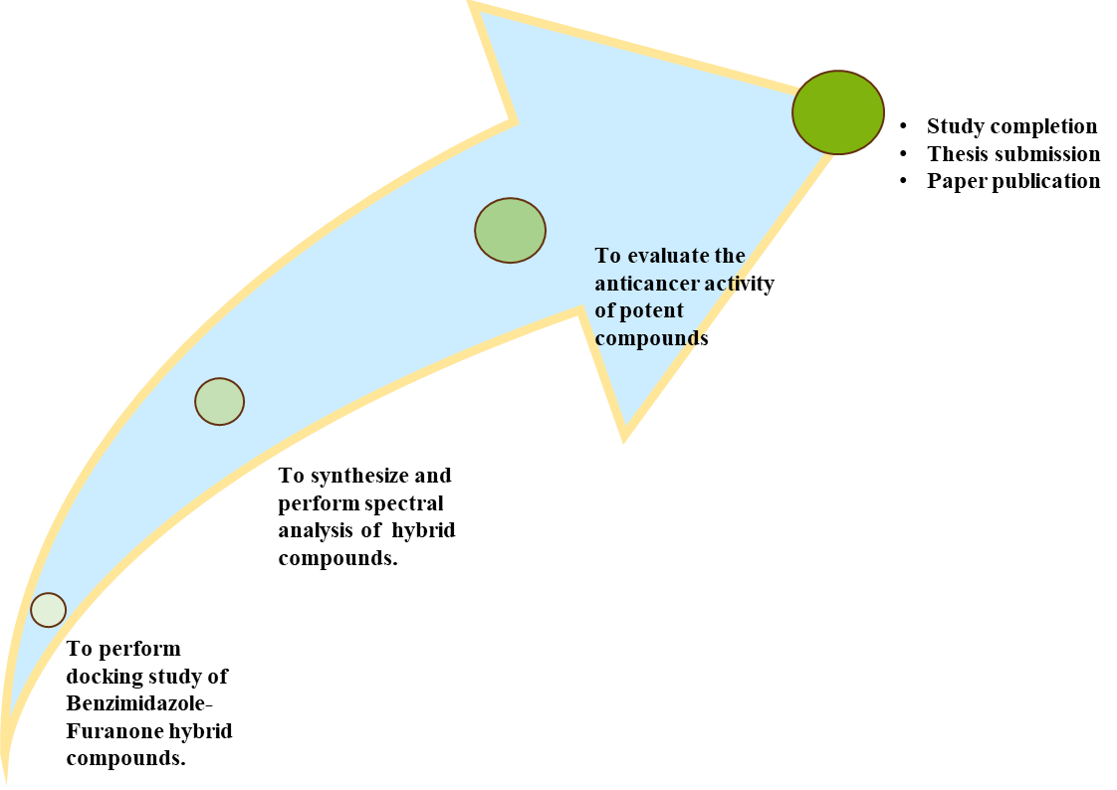

Benzimidazole-Furanone Hybrid compound consist of 2 pharmacophore – Benzimidazole and Furanone, they can inhibit growth of cancer cells more efficiently by acting on two different mechanisms responsible for growth of cancer cell i.e., by acting as alkylating agent, HDAC inhibitor, Anti tubulin agent, PARP inhibitor (for Benzimidazole) and G2 phase of cellular cycle (for Furanones).
In terms of interaction at binding site, proposed pharmacophoric model should have a lipophilic aryl ring (A), a hydrogen binding domain(HBD), electron donor moiety, and a second aryl designated as distal aryl group (B), to increase the vander wall bonding at the binding site and to increase the pharmacokinetic properties of the compound.

Slide 36

The title compounds (17 new compounds; 09 furanones, 06 pyrrolones and 02 oxadiazoles) were prepared by multi-step synthesis method in the following four steps:
2a, R = 4-fluoro; 2b, R = 4-dimethylamino; 2c, R = 2-chloro; 2d, R = 2,6-difluoro; 2e, R = 3-ethoxy-4-hydroxy; 2f, R = thiophen-2-yl; 2g, R = furan-2-yl; 2h, R = 3-chloro; 2i, R = 3-phenylallylidene.
3a, R = 2,6-difluoro; 3b, R = 3-chloro; 3c, R = 3-ethoxy-4-hydroxy; 3d, R = 2-chloro; 3e, R = furan-2-yl; 3f, R = 4-dimethylamino.
4a, R = pyridine-4-yl; 4b, R = benzyl.
Scheme 1: Synthesis of title compounds.

Slide 37
Synthesis of the starting material: 4-(1H-benzo[d]imidazol-2-yl)-4-oxobutanoic acid (1)
A solution of o-phenylenediamine (0.01 mol) and α-ketoglutaric acid (equimolar; 0.01 mol) in a mixture of methanol and water (1:1) was subjected to the gradual addition of 4N HCl (5 mL).
The resulting mixture was refluxed and stirred for a duration of 6-8 hours while maintaining a temperature range of 70-80 °C.
The NaOH solution (10% w/v) will be added slowly to neutralize the reaction mixture, a solid mass (light yellow) precipitated out was filtered, washed with water.

Slide 38
Synthesis of furanones (2a-i) from 4-(benzo(d)imidazol-2-yl)-4-oxobutanoic acid (1):
2a, R = 4-fluoro; 2b, R = 4-dimethylamino; 2c, R = 2-chloro; 2d, R = 2,6-difluoro; 2e, R = 3-ethoxy-4-hydroxy; 2f, R = thiophen-2-yl; 2g, R = furan-2-yl; 2h, R = 3-chloro; 2i, R = 3-phenylallylidene.
A mixture of an appropriate aromatic aldehyde (3 mmol) and 4-(benzo[d]imidazol-2-yl)-4-oxobutanoic acid (1) in acetic anhydride (5-10 mL) was prepared in a round bottom flask, along with a small quantity of triethylamine (3-4 drops).
The reaction mixture was heated under reflux for 3-4 hours under anhydrous conditions; once the reaction was complete (monitored by TLC), the contents were gradually added to crushed ice while stirring.
A solid mass with a distinct color formed and was separated by filtration, followed by washing with water. The solid was then dried and subjected to crystallization from methanol, resulting in the formation of a pure compound (2a-i) as confirmed by TLC.

Slide 39
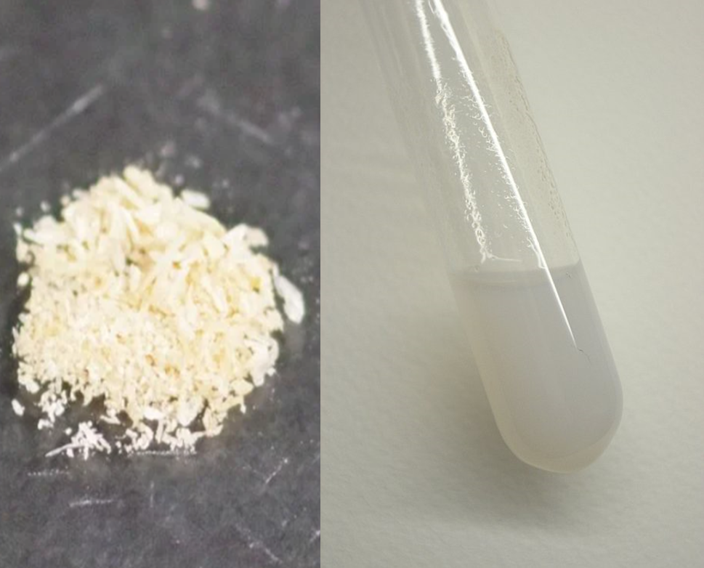
Synthesis of Pyrrolones (3a-f) from Furanones
3a, R = 2,6-difluoro; 3b, R = 3-chloro; 3c, R = 3-ethoxy-4-hydroxy; 3d, R = 2-chloro; 3e, R = furan-2-yl; 3f, R = 4-dimethylamino.
A mixture consisting of 0.2 grams of furanone, 5 mL of ethanol, 3 mL of concentrated aqueous ammonia (30% v/v), and 1 mL of water was subjected to reflux for a duration of 30 minutes.
Following this, 1 mL of ammonia solution and 0.2 grams of potassium carbonate were added, and the heating process was continued for 2-3 hours. Additional ammonia solution (0.5-1mL) was added during this time.
The resulting solid product was washed with hot water, dried, and subsequently recrystallized from methanol to obtain a pure compound (3a-f) as confirmed by TLC analysis.

Slide 40
Synthesis of oxadiazoles (4a-b) from 4-(benzo(d)imidazol-2-yl)-4-oxobutanoic acid (1):
4a, R = pyridine-4-yl; 4b, R = benzyl.
A mixture containing acid hydrazide (0.5 mmol) and 4-(benzo[d]imidazol-2-yl)-4-oxobutanoic acid (1) (0.5 mmol) in phosphoryl chloride (3-5 mL) was placed in a round-bottom flask.
The reaction mixture was heated under reflux for 3-4 hours, ensuring anhydrous conditions. After the completion of the reaction (monitored by TLC), the contents were gradually introduced to crushed ice
The resulting mixture was subsequently neutralized with NaOH. A solid mass exhibiting a distinct color was isolated through the process of filtration. The solid was washed with water, dried, and subjected to crystallization from methanol, resulting in the formation of a pure compound (4a-b) as confirmed by TLC analysis.

Slide 41
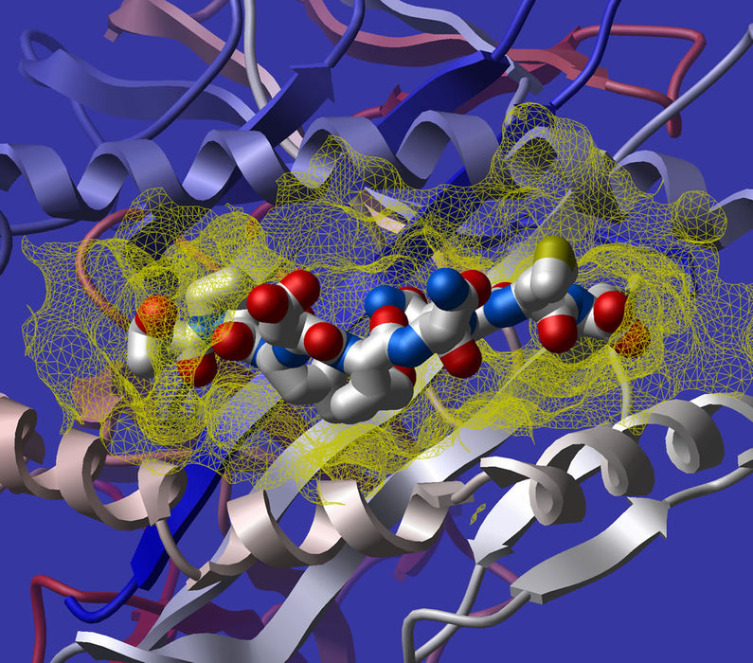
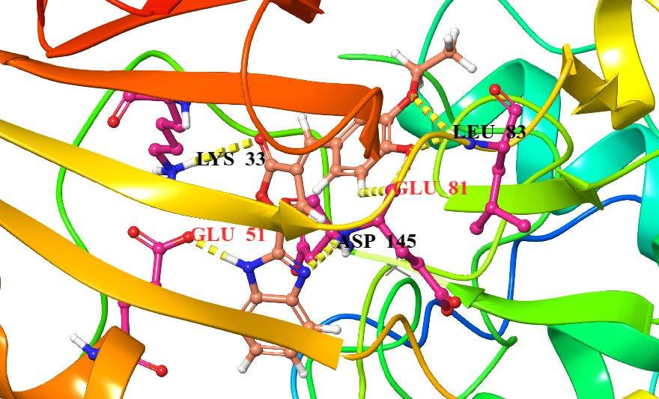
Docking studies were performed to study the molecular binding pattern of synthesized benzimidazole–furanone conjugate derivatives, within the binding site of Cyclin Dependent Kinase 2 (CDK2; PDB ID: 5A14). using Schrodinger’s Maestro 10.5 program.
Purpose of this study: To investigate the binding characteristics of the test compounds, because of the role of CDK2 in pancreatic angiogenesis, pancreatic tumor growth, and pancreatic metastasis, it is considered as a promising target for pancreatic anticancer therapy.
Two compounds (2e and 2i showed the most promising in vitro anticancer activity) with docking scores of: -11.873 and -11.769 respectively appears to form hydrogen bonds with the target receptor.
Docked posed conformer of compound 2e
Compounds | Docking Score
2e | -11.873
2i | -11.769
2d | -11.558
2h | -11.332

Slide 42
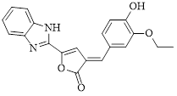
Docking Pose:
Compound 2e: 5-(1H-benzo[d]imidazol-2-yl)-3-(3-ethoxy-4-hydroxybenzylidene) furan-2(3H)-one
2D view of compound 2e explained that it forms hydrophobic interaction with Ala 31, Leu 148, Phe 146, Ala 144, Leu 143, Leu 54, Leu 55, Leu 58, Val 64, Ile 63, Phe 80, Phe 82, and Leu 83.
The aromatic ring and chain also form weak van der Waals interactions with a non-polar group of the side chain of Val 18, Phe 152, and Leu 134.
The charged interaction also takes place with Asp 145, Glu 51, and Glu 81.

Slide 43
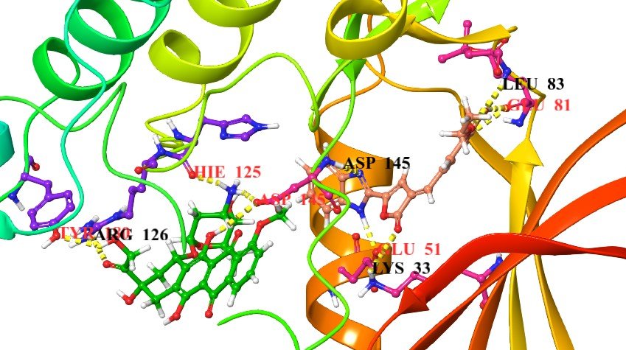
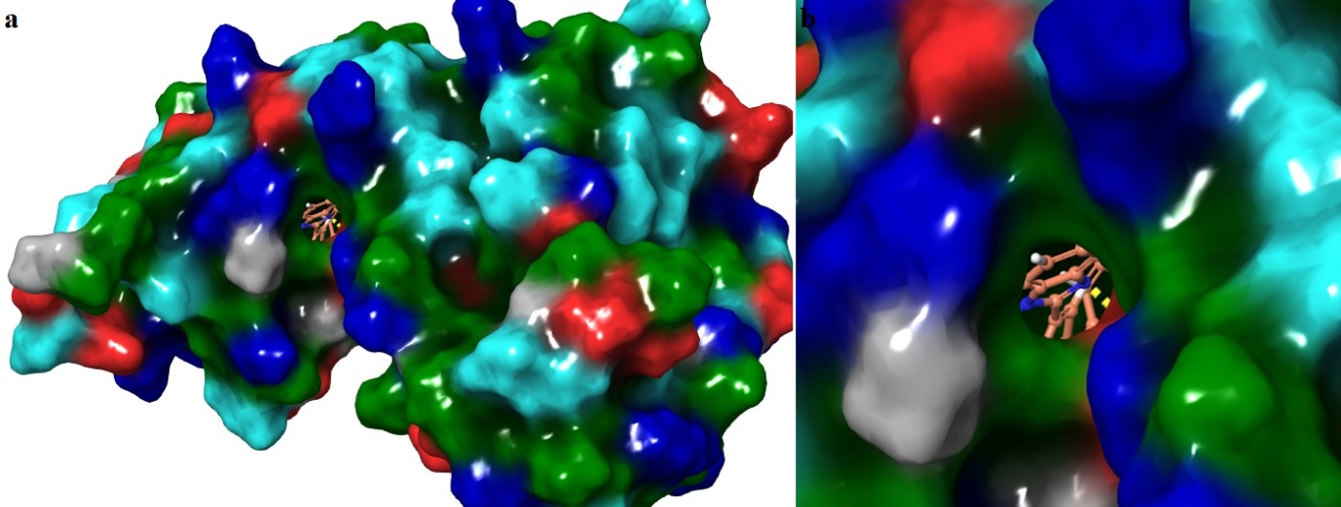
Superimpose of potent compound 2e (reddish-brown) and doxorubicin (green) displayed common H-bonds with Asp145 (represented by yellow colour)
The Surface view of the compound 2e showed that compound completely fit in the receptor pocket of the targeted enzyme

Slide 44
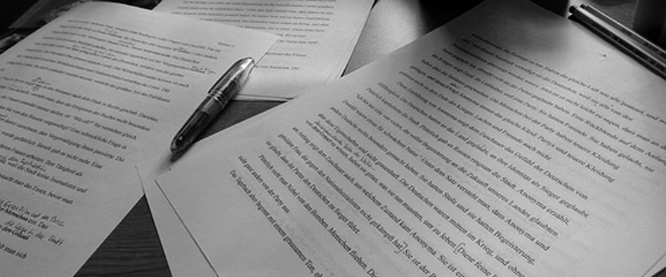
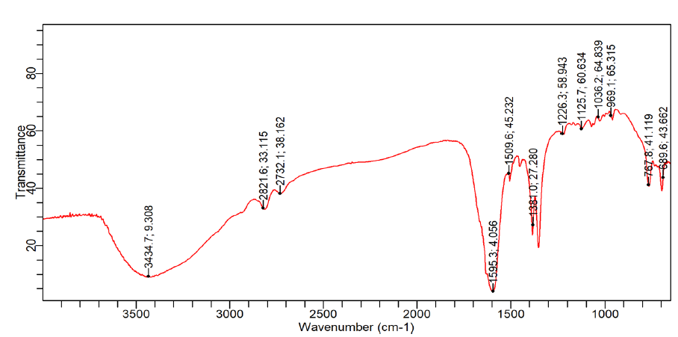
Starting material: 4-(1H-benzo[d]imidazol-2-yl)-4-oxobutanoic acid (1)
IR (KBr) ν_{max} cm⁻¹: 3510 (N-H), 3104 (aromatic C-H stretching), 2500 (OH acid), 1725-1700 (C=O Acid), 1616 (C=N), 1660 (C=O), 1528 (C=C aromatic), 1248 (C-N)
Anal. calcd. for C₁₁H₁₀N₂O₃: C, 54.79; H, 4.14; N, 19.17. Found: C, 54.92; H, 4.24; N, 19.29.

Slide 45
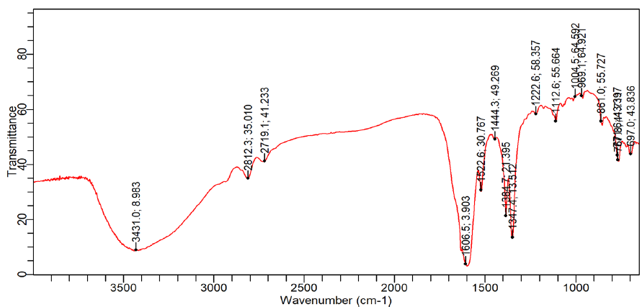
5-(1H-benzo[d]imidazol-2-yl)-3-(3-ethoxy-4-hydroxybenzylidene)furan-2(3H)-one (2e):
IR (KBr) ν_{max} cm⁻¹: 3510 (N-H), 3440-3570 (O-H broad band), 3104 (aromatic C-H stretching), 1660 (C=O), 1650 (C=C aliphatic), 1616 (C=N), 1528 (C=C aromatic), 1305 (C-O-C stretching), 1248 (C-N).

Slide 46
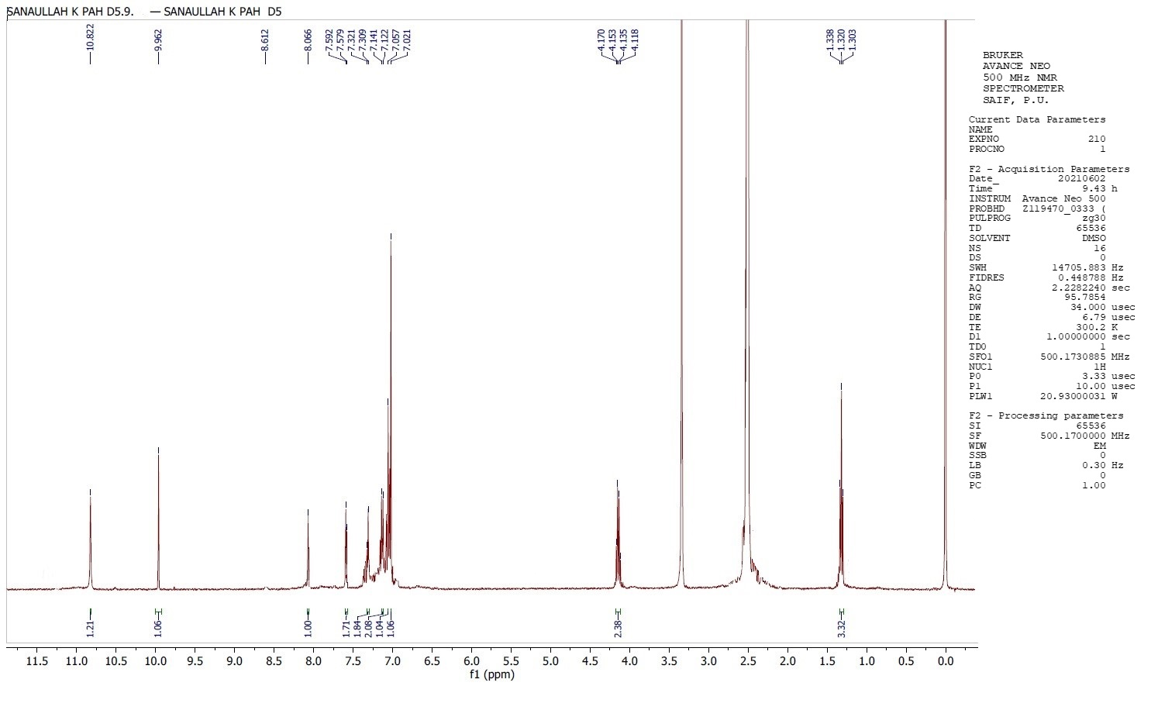
5-(1H-benzo[d]imidazol-2-yl)-3-(3-ethoxy-4-hydroxybenzylidene)furan-2(3H)-one (2e):
¹H-NMR (400 MHz, DMSO-d₆): δ (ppm) 1.33-1.32 (t, 3H, J = 6.8 Hz, -CH₃), 4.15-4.13 (q, 2H, J = 7.2 Hz, -CH₂), 7.02 (s, 1H, furanone), 7.04 (s, 1H, Ar), 7.14-7.13 (m, 2H, Ar), 7.36-7.34 (m, 2H, Ar), 7.59-7.57 (m, 2H, Ar), 8.04 (s, =CH, ethylenic bridge), 9.96 (s, 1H, -OH), 10.82 (s, 1H, NH, Indolyl).

Slide 47
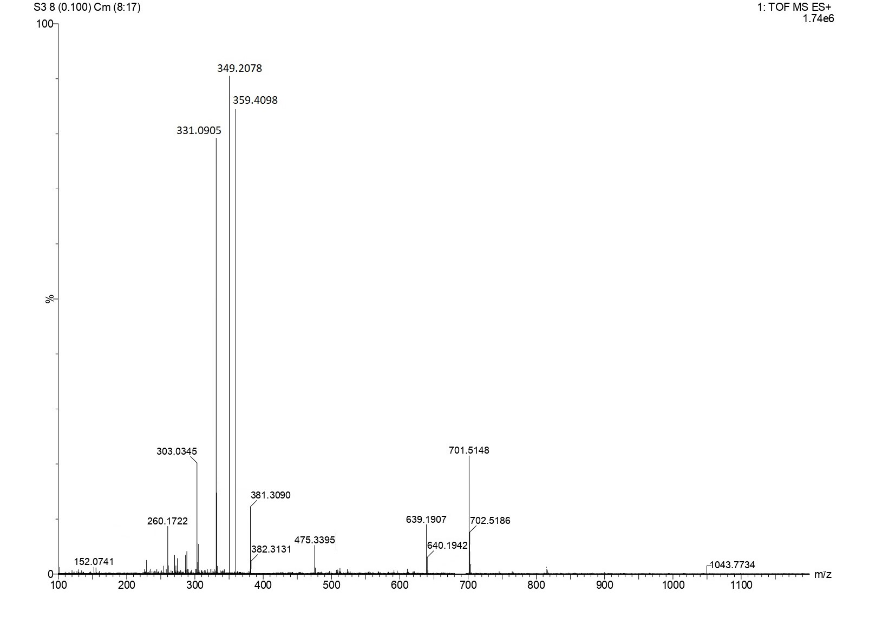
5-(1H-benzo[d]imidazol-2-yl)-3-(3-ethoxy-4-hydroxybenzylidene)furan-2(3H)-one (2e):
MS (m/z): 349.20 (M⁺).

Slide 48
Table: Physical and analytical data of synthesized compounds (2a-i, 3a-f, 4a,b)
Compound | Molecular Formula | Molecular Weight | M.P. (ºC) | R_{f} *Value | Color | Yield (%)
2a | C₁₈H₁₁FN₂O₂ | 306.08 | 152 | 0.62 | Light Pink | 74.3
2b | C₂₀H₁₇N₃O₂ | 331.38 | 166 | 0.73 | Dark Purple | 62.5
2c | C₁₈H₁₁ClN₂O₂ | 322.75 | 126 | 0.58 | Pink | 72.6
2d | C₁₈H₁₀F₂N₂O₂ | 324.29 | 117-119 | 0.80 | Grey | 58.7
2e | C₂₀H₁₆N₂O₄ | 348.36 | 143-145 | 0.77 | Pink | 67.8
2f | C₁₆H₁₀N₂O₂S | 294.33 | 124 | 0.63 | Lilac Pink | 76.4
2g | C₁₆H₁₀N₂O₃ | 278.27 | 134 | 0.71 | Light Purple | 61.8
2h | C₁₈H₁₁ClN₂0₂ | 322.75 | 122 | 0.78 | Tyrian Purple | 70.4
2i | C₂₀H₁₄N₂O₂ | 314.34 | 163-165 | 0.72 | Purple | 81.3
3a | C₁₈H₁₁F₂N₃O | 323.30 | 137 | 0.68 | Light Brown | 56.3
3b | C₁₈H₁₂ClN₃O | 321.76 | 157 | 0.59 | Brownish Grey | 57.1
3c | C₂₀H₁₇N₃O₃ | 347.37 | 177 | 0.61 | Dark Brown | 48.9
3d | C₁₈H₁₂ClN₃O | 321.76 | 132 | 0.75 | Brown | 68.4
3e | C₁₆H₁₁N₃O₂ | 277.28 | 155 | 0.69 | Dark Brown | 57.2
3f | C₂₀H₁₈N₄O | 330.39 | 181 | 0.80 | Greyish Brown | 60.2
4a | C₁₇H₁₃N₅O₂ | 319.32 | 119 | 0.74 | Beige | 80.3
4b | C₁₉H₁₆N₄O₂ | 332.26 | 195 | 0.80 | Dark Yellow | 74.8
*Solvent system used for TLC of compounds; for 2a-i, T:E:F (Toluene: Ethyl acetate: Formic Acid) = 5:4:1, for 3a-f and 4a,b B: A (Benzene: Acetone) =7:3, C:M (Chloroform: Methanol) = 9:1

Slide 49
Biological Screening of Anticancer Activity:
Percentage (%) survival of cells:
MTT Calorimetric Assay:
Percentage (%) survival of cells refers to the assessment of the percentage of viable and healthy cells in a given population.
Cell survival assays primarily serve the purpose of screening how cells respond to drugs or chemical agents.
The "Number of viable cells after treatment" refers to the count of cells that remain alive or viable after exposure to the experimental condition, such as a drug, toxin, or treatment. This count can be determined using various cell viability assays, such as trypan blue exclusion, MTT assay, or others.
Cell survival was calculated by the following formula: Survival (% of control cells) = [(A₅₇₀ − A₆₃₀) of treated cells] × 100/ [(A₅₇₀ − A₆₃₀) of control cells]
This assay is based on a colorimetric principle, where a yellow, water-soluble dye called 3-(4,5-dimethylthiazol-2-yl)-2,5-diphenyl tetrazolium bromide (MTT) is reduced by mitochondrial succinate dehydrogenase to form a water-insoluble dark purple compound called formazan.
MTT enters the cells, including the mitochondria. The amount of formazan produced is directly proportional to the number of viable cells, thus measuring the metabolic activity of living cells.

Slide 50
In vitro anticancer activity:
Cytotoxicity was assessed on single human tumor cell line: PANC-1 (human pancreatic cancer cell line isolated from a pancreatic carcinoma of ductal cell origin).
The viability of the tumor cell lines was measured using a colorimetric assay at a wavelength of 570 nm on a multiplate reader.
The IC₅₀ values (50% inhibitory concentration) were calculated based on the absorbance data from the dose-response curves.
The results are presented as the mean ± standard deviation (S.D.) of the IC₅₀ values (in µM).
S. No. | Compound | IC₅₀ values (µM ± S.D)
1 | 2b | 65.04 ± 22.55
2 | 2c | 53.23 ± 18.24
3 | 2e | 38.54 ± 10.31
4 | 2d | 68.02 ± 20.99
5 | 2i | 49.11 ± 14.78
6 | 4a | 55.04 ± 31.63

Slide 51
Biological Screening of Anticancer Activity:
Anticancer activity determined against same PANC-1 cell line revealed that compound 2e named 5-(1H-benzo[d]imidazol-2-yl)-3-(3-ethoxy-4-hydroxybenzylidene)furan-2(3H)-one showed excellent activity against PANC-1 (at 100 µm) with % survival 41.518.
Another compound 2i named 5-(1H-benzo[d]imidazol-2-yl)-3-(3-phenylallylidene)furan-2(3H)-one also exhibited very good activity against PANC1 (at 100 µm) with % survival 42.173.
% Survival
 |  | Control | 12.5uM | 25uM | 50uM | 100uM
A | 2b | 100 | 118.743 | 124.600 | 105.307 | 85.824
B | 2c | 100 | 96.660 | 100.573 | 95.204 | 92.293
C | 2e | 100 | 86.973 | 89.200 | 60.466 | 41.518
D | 2d | 100 | 101.091 | 87.187 | 73.754 | 41.818
E | 2i | 100 | 90.034 | 62.767 | 64.692 | 42.173
F | 4a | 100 | 104.733 | 103.528 | 85.232 | 89.702

Slide 52
Biological Screening of Anticancer Activity:
The analysis was performed at an interval of 24 hours against same cell line (PANC-1) revealed that compound 2e named 5-(1H-benzo[d]imidazol-2-yl)-3-(3-ethoxy-4-hydroxybenzylidene) furan-2(3H)-one showed activity against PANC-1 (at 100 µm) with % survival 40.640.
Another compound 2i named 5-(1H-benzo[d]imidazol-2-yl)-3-(3-phenylallylidene)furan-2(3H)-one also exhibited very good activity against PANC1 (at 100 µm) with % survival 48.338.
% Survival
 |  | Control | 12.5uM | 25uM | 50uM | 100uM
A | 2b | 100 | 111.720 | 99.912 | 100.854 | 82.921
B | 2c | 100 | 91.672 | 76.222 | 84.641 | 51.901
C | 2e | 100 | 85.710 | 75.907 | 63.532 | 40.640
D | 2d | 100 | 97.314 | 78.938 | 73.046 | 66.850
E | 2i | 100 | 70.974 | 60.838 | 50.398 | 48.338
F | 4a | 100 | 120.976 | 81.385 | 97.245 | 36.560

Slide 53


In the present study, 17 new benzimidazole bearing furanones/pyrrolones (09 furanones, 06 pyrrolones) and 2 oxadiazole derivatives were synthesized in four steps:
Step I: Starting is the present material, 4-(1H-benzo[d]imidazol-2-yl)-4-oxobutanoic acid (1), was synthesized by condensing o-phenylenediamine with α-ketoglutaric acid.
Step II: 5- benzo[d]imidazol-2-yl)-3-(4-arylidene)furan-2(3H)-one (2a-i) were synthesized by acting the starting material (1) with different substituted aromatic aldehydes in acetic anhydride in presence of catalytic amount of triethylamine (TEA).
Step III: 5-(1H- benzo[d]imidazole-2-yl)-3-arylidene-1H-pyrrol-2(3H)-ones (3a-f) were synthesized by treating furanones with ammonia in ethanol.
Step IV: 1-(1H-benzo[d]imidazol-2-yl)-3-(5 aryl)-1,3,4-oxadiazol-2-yl)propan-1-one (4a,b) were synthesized in one-pot synthesis; 4-(1H-benzo[d]imidazol-2-yl)-4-oxobutanoic acid (1) by treating with different acid hydrazine and phosphoryl chloride in anhydrous condition
In vitro antitumor (anticancer) activity by MTT colorimetric assay against a panel of human pancreatic cancer cell line: 5-(1H-benzo[d]imidazol-2-yl)-3-(3-ethoxy-4-hydroxybenzylidene)furan-2(3H)-one (2e) and 5-(1H-benzo[d]imidazol-2-yl)-3-(3-phenylallylidene)furan-2(3H)-one (2i) exhibited excellent activity against PANC-1 with IC₅₀ value 38.54 ± 10.31 and 49.11 ± 14.78 respectively.
Docking studies were also performed which supported the results of anticancer activity as most potent compound 2e showed -11.873 as docking score.

Slide 54

Husain A, Khan SA, Iram F, Iqbal MA, Asif M. Insights into the chemistry and therapeutic potential of furanones: A versatile pharmacophore. European journal of medicinal chemistry. 2019 Jun 1;171:66-92.
Hsieh CY, Ko PW, Chang YJ, Kapoor M, Liang YC, Chu HL, Lin HH, Horng JC, Hsu MH. Design and synthesis of benzimidazole-chalcone derivatives as potential anticancer agents. Molecules. 2019 Sep 6;24(18):3259.
Zhang YL, Yang R, Xia LY, Man RJ, Chu YC, Jiang AQ, Wang ZC, Zhu HL. Synthesis, anticancer activity and molecular docking studies on 1, 2-diarylbenzimidazole analogues as anti-tubulin agents. Bioorganic Chemistry. 2019 Nov 1;92:103219.
Haoran W, Akhtar W, Nainwal LM, Kaushik SK, Akhter M, Shaquiquzzaman M, Alam MM. Synthesis and biological evaluation of benzimidazole pendant cyanopyrimidine derivatives as anticancer agents. Journal of Heterocyclic Chemistry. 2020 Sep;57(9):3350-60.
Perin N, Hok L, Beč A, Persoons L, Vanstreels E, Daelemans D, Vianello R, Hranjec M. N-substituted benzimidazole acrylonitriles as in vitro tubulin polymerization inhibitors: Synthesis, biological activity and computational analysis. European Journal of Medicinal Chemistry. 2021 Feb 5;211:113003.

Slide 55
Shinde VS, Lawande PP, Sontakke VA, Khan A. Synthesis of benzimidazole nucleosides and their anticancer activity. Carbohydrate Research. 2020 Dec 1;498:108178.
Rasal NK, Sonawane RB, Jagtap SV. Potential 2, 4-dimethyl-1H-pyrrole-3-carboxamide bearing benzimidazole template: Design, synthesis, in vitro anticancer and in silico ADME study. Bioorganic Chemistry. 2020 Apr 1;97:103660.
Byczek-Wyrostek A, Kitel R, Rumak K, Skonieczna M, Kasprzycka A, Walczak K. Simple 2 (5H)-furanone derivatives with selective cytotoxicity towards non-small cell lung cancer cell line A549–Synthesis, structure-activity relationship and biological evaluation. European journal of medicinal chemistry. 2018 Apr 25;150:687-97.
Irie T, Asami T, Sawa A, Uno Y, Hanada M, Taniyama C, Funakoshi Y, Masai H, Sawa M. Discovery of novel furanone derivatives as potent Cdc7 kinase inhibitors. European Journal of Medicinal Chemistry. 2017 Apr 21;130:406-18.
Wei MX, Zhang J, Ma FL, Li M, Yu JY, Luo W, Li XQ. Synthesis and biological activities of dithiocarbamates containing 2 (5H)-furanone-piperazine. European Journal of Medicinal Chemistry. 2018 Jul 15;155:165-70.
Wu YC, Luo SH, Mei WJ, Cao L, Wu HQ, Wang ZY. Synthesis and biological evaluation of 4-biphenylamino-5-halo-2 (5H)-furanones as potential anticancer agents. European journal of medicinal chemistry. 2017 Oct 20;139:84-94.

Slide 56


